Slide 1

An Introduction to UpdateMe
By Paige DeVeau and Abhinoor Singh

Slide 2

Introduction
UpdateMe is a mobile application that allows users to set up notifications for various types of information, such as weather, news, stocks, and more. The user can customize the types of notifications they receive, and the application will send an email at a set time with the selected information. The application is designed to help users stay informed about important updates without having to constantly check their phone.

Slide 3



Tech Stack
FastAPI()
ReactNative()
MongoDB()
FastAPI is a modern, fast (high-performance), web framework for building APIs with Python 3.7+ based on standard Python type hints.
React Native combines the best parts of native development with React, a best-in-class JavaScript library for building user interfaces.
An integrated suite of cloud database and data services to accelerate and simplify how you build with data.
UpdateMe’s Backend is Deployed on Google Cloud Run

Slide 4
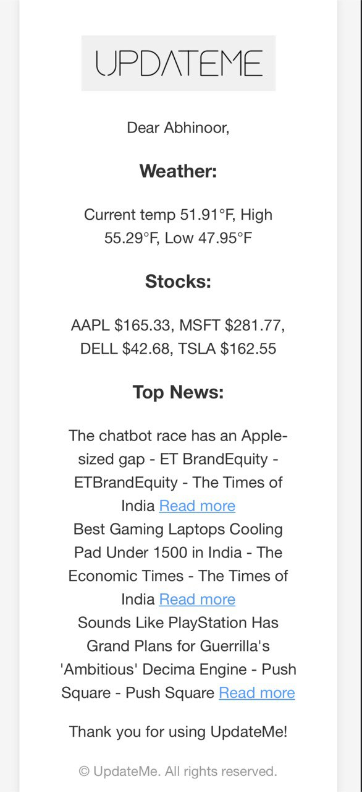
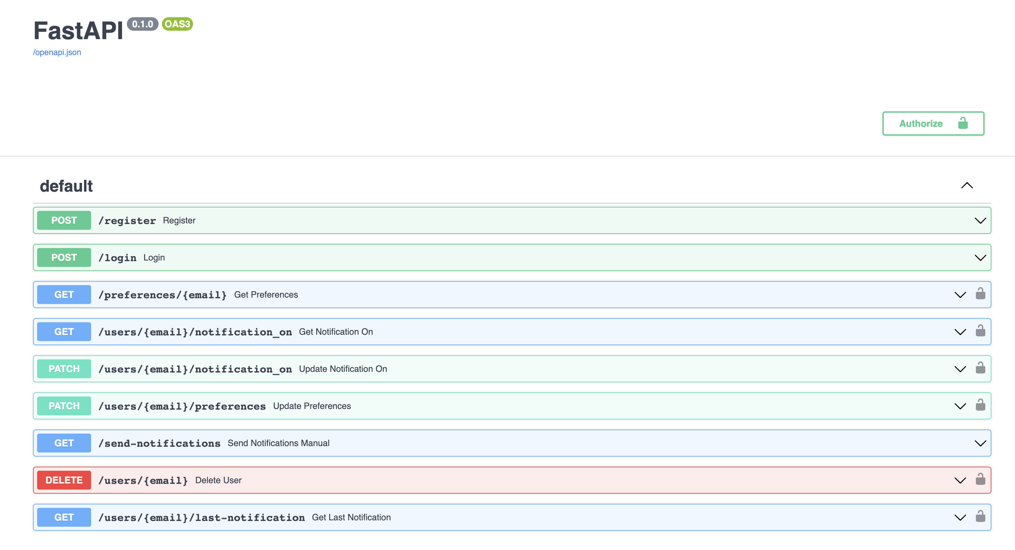
FastAPI Overview
FastAPI is a modern, fast, web framework for building APIs with Python 3.6+ based on standard Python type hints. It is one of the fastest and most reliable frameworks available for developing RESTful APIs.

Slide 5



React Native Benefits
CROSS-PLATFORM DEVELOPMENT
FASTER DEVELOPMENT
COST-EFFECTIVE
React Native allows developers to create apps for both iOS and Android with one codebase.
React Native enables faster development cycles with its hot reloading feature.
React Native is an open-source platform, making it a cost-effective solution for app development.
REACT NATIVE OFFERS MANY BENEFITS FOR DEVELOPERS, MAKING IT AN IDEAL CHOICE FOR CREATING APPS WITH UPDATEME.

Slide 6

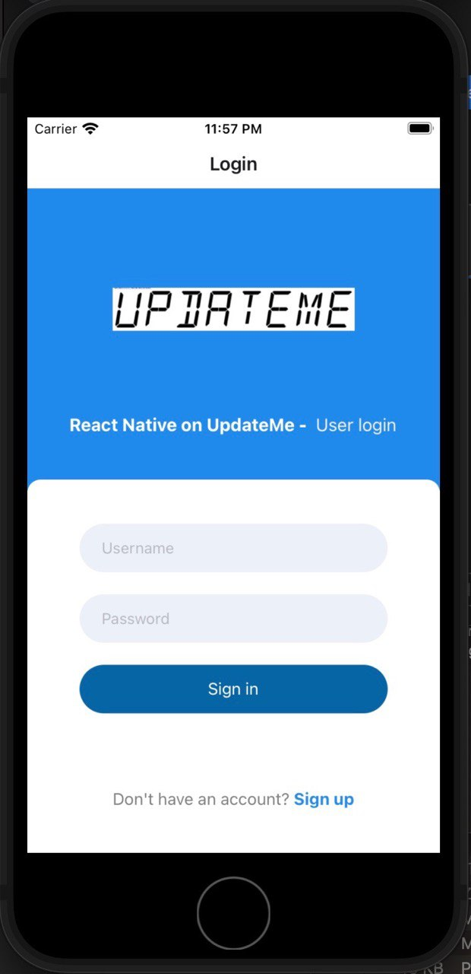
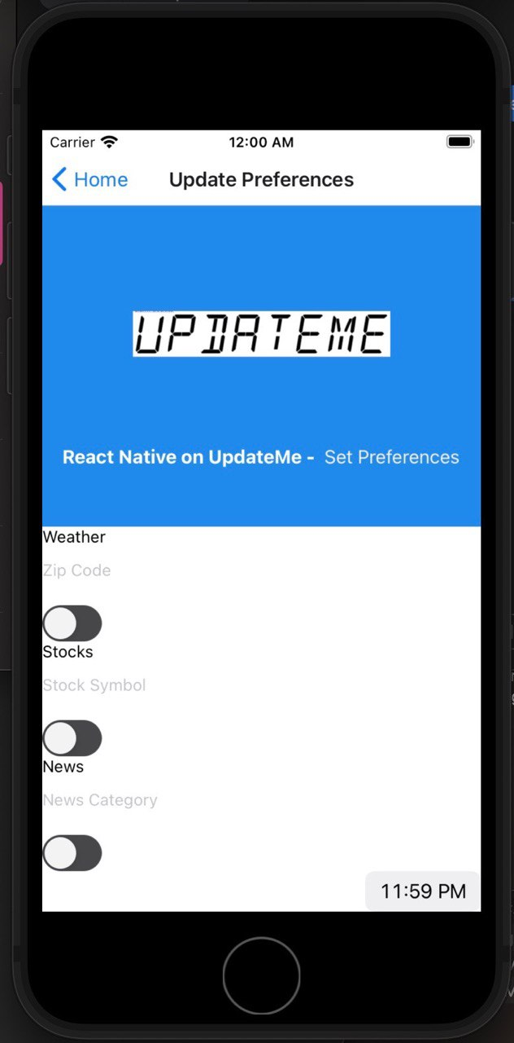
UI Overview

Slide 7




Project Timeline
April 13th 2023
MAY 1, 2023
UpdateMe project begins
UpdateMe Frontend Completed and Beta Tested
April 20th 2023
May 3, 2023
UpdateMe Backend Beta Completed + Deployed to Cloud Run
UpdateMe App Version 1.0 Completed

Slide 8

The Future of UpdateMe
UpdateMe is written with abstraction in mind.
Has the potential for 100’s of possible notifications such as sports updates, uplifting message of the day, etc.
Additional features can be added easily, and using a DB like MongoDB Atlas allows for expandability.

Slide 9

Questions

